Slide 1


Online Videogame Growth & Engagement

Slide 2

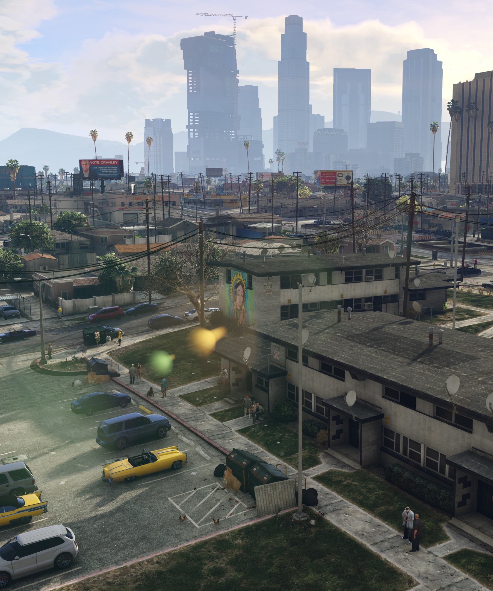
Proposal
We are interested in examining the number of players over a three-year period to see the trends and changes in playerbase of Steam video games.
These visualizations will Illustrate the growth of videogames and videogame streaming between 2018-2020.
The datasets we are using will come from steamdb.info, which tracks the number of players for each video game in the Steam database and concurrent Twitch viewership.

Slide 3
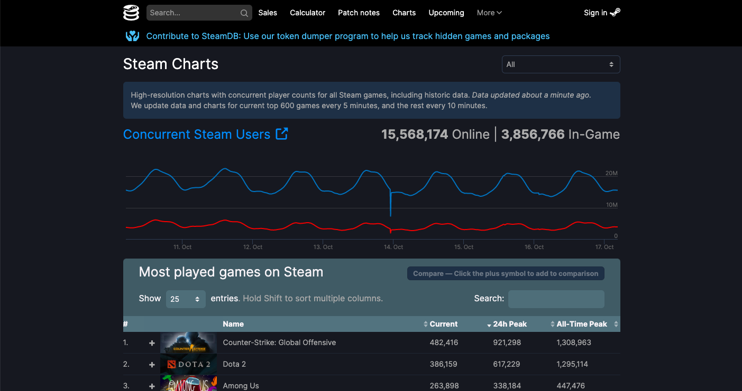
What is Steam?
Steam is a video game digital distribution service by Valve.
It was launched as a standalone software client in September 2003 as a way for Valve to provide automatic updates for their games and expanded to include games from third-party publishers.
Steam has also expanded into an online web-based and mobile digital storefront and offers digital rights management (DRM), server hosting, video streaming, and social networking services. It also provides the user with installation and automatic updating of games, and community features such as friends lists and groups, cloud storage, and in-game voice and chat functionality.

Slide 4
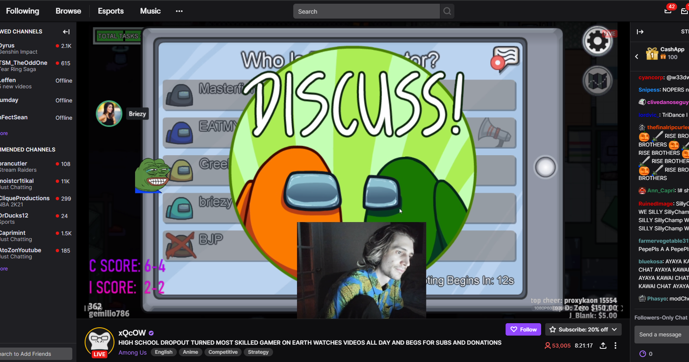
What is Twitch?
Twitch is a video live streaming service operated by Twitch Interactive, a subsidiary of Amazon. Introduced in June 2011, the site primarily focuses on video game live streaming, including broadcasts of esports competitions, in addition to music broadcasts, creative content, and more recently, "in real life" streams. Content on the site can be viewed either live or via video on demand.

Slide 5
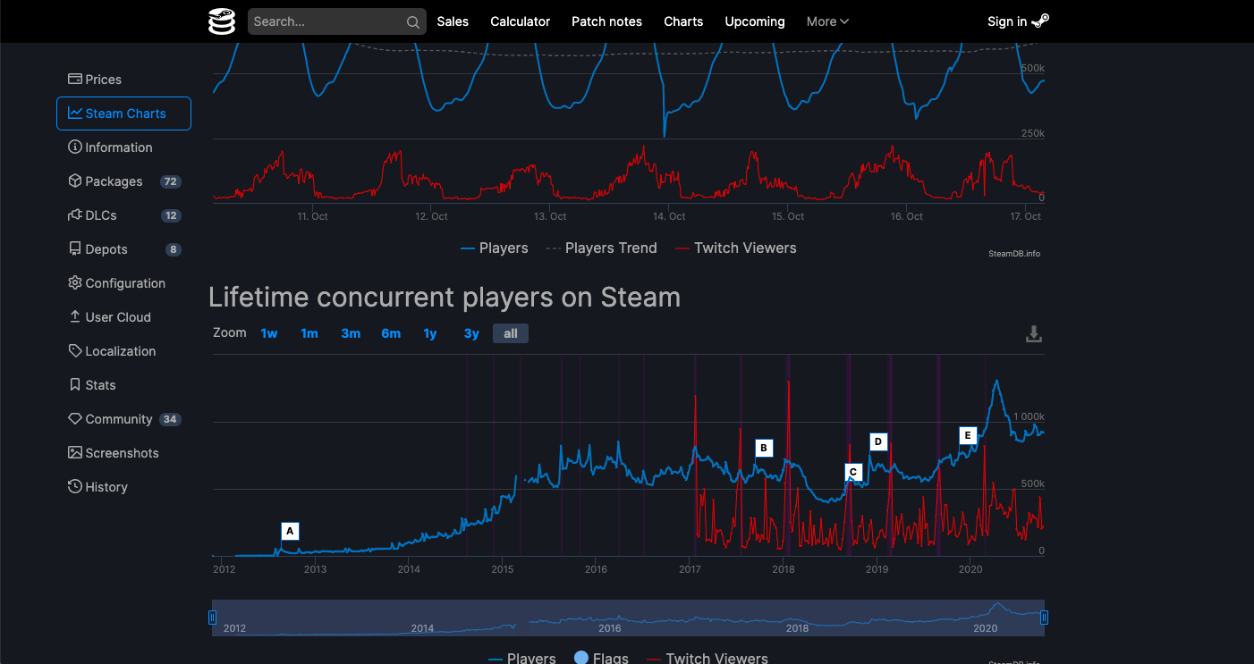
Methodology
Picked 5 popular genre of videogames:
Strategy
RPG (Role-Playing game)
Sports
Platformer
FPS (First Person Shooter)
Selected 10 games/genre by release date (released prior to 2020)

Slide 6

Methodology, cont’d
Imported data into aws-hosted sql server
Wrote queries to perform data manipulation etl

Slide 7
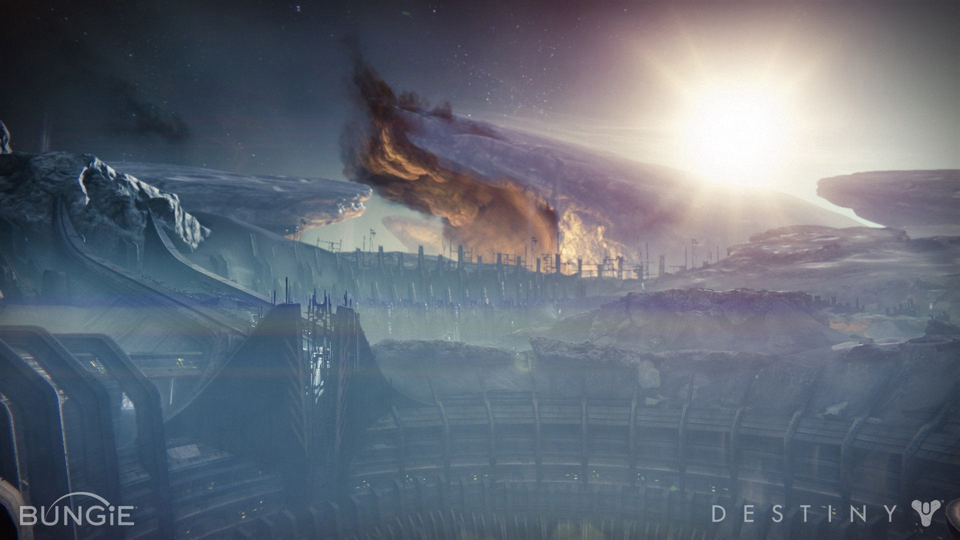
The homepage
Our homepage is the hub for all of our visualizations
Homepage is created using Flask
The code works by reading a JSON table from our Flask app
Visualizations generated using d3 and/or Plotly
Navbar is used to switch visualizations

Slide 8

Visualization: Videogame Bandwidth
This visualization gathers data from our database of the genres and the total activity/date, including users and Twitch viewers
This bandwidth chart gives a general outline between 2018-present day on the trends of the 5 genres
Using the stock version of the bandwidth chart, the data was applied to the function and the data is parsed to use the total activity count with axes being dates and genre

Slide 9

Viz 2
This Line chart represents the growth of twitch viewership over time
the data was separated by genre to see if there was any difference in viewership between the different genres of games
The axes are represented by Year and number of Twitch Viewers
A tooltip on mouseover is included to distinguish between the different genres

Slide 10

Visualization: Steam Users & Twitch Viewers by Genre Over Time
Scatter plot that charts the sum of player count for 10 games/genre over time
The table is grouped by day and sorted by genre
The axes buttons represent the slicing of the data
The Y-axes buttons allow you to see either Steam Player data or Twitch Viewer data
The X-axes buttons change the genre and switch which set of data is being plotted

Slide 11
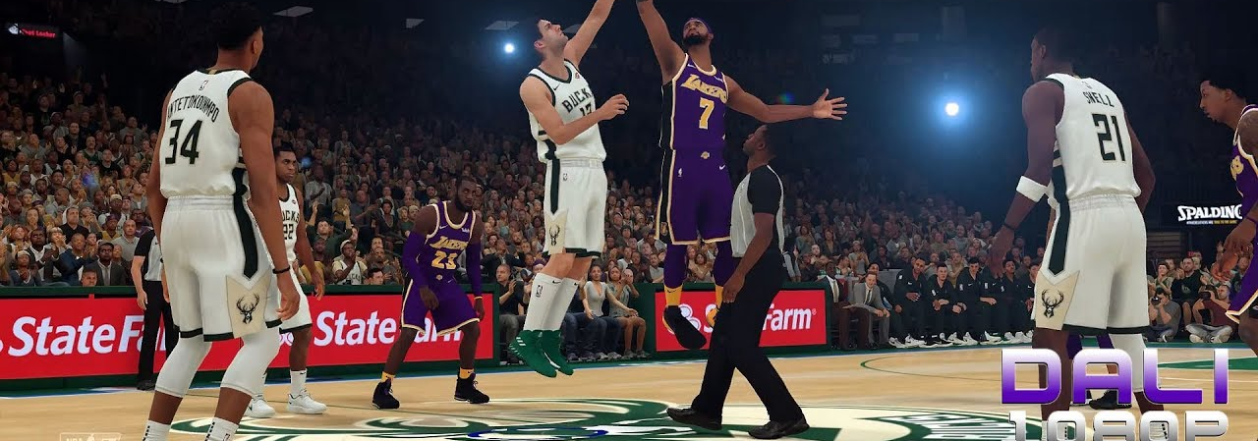
Game Users & Twitch Viewers Year over Year By Game
Sunburst chart showing category growth of users over time by genre inclusive of Twitch Viewers and Steam Users
Data was summed by year, separated by game and user
A Plotly chart was created to connect all of the data by category and year and games available that year, plus the number of players and viewers

Slide 12
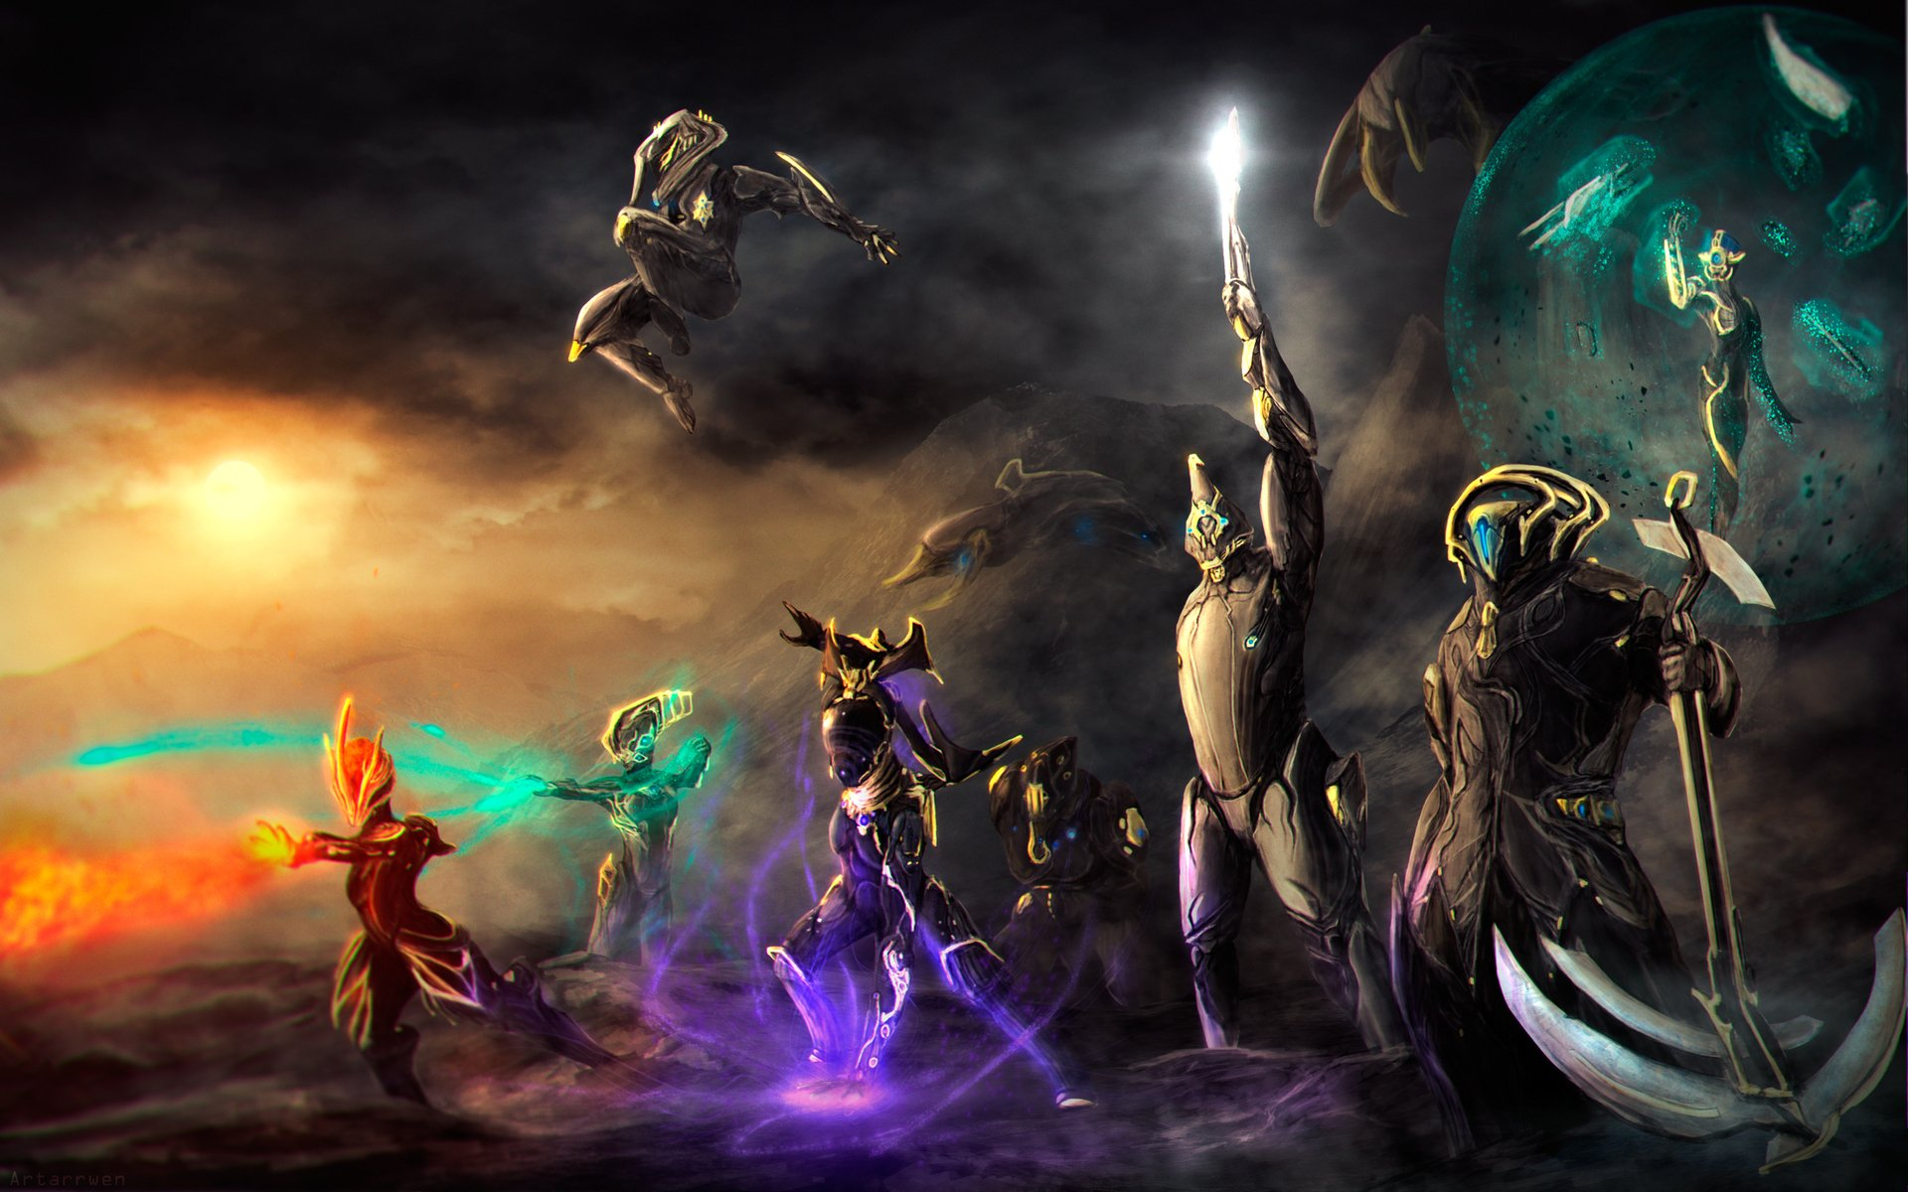
ggez

